Slide 1
Java Basics

Slide 2
Installation of OpenJDK 21
https://learn.microsoft.com/en-us/java/openjdk/download#openjdk-21
Mac M1, M2, M3
https://formulae.brew.sh/formula/openjdk@21

Slide 3
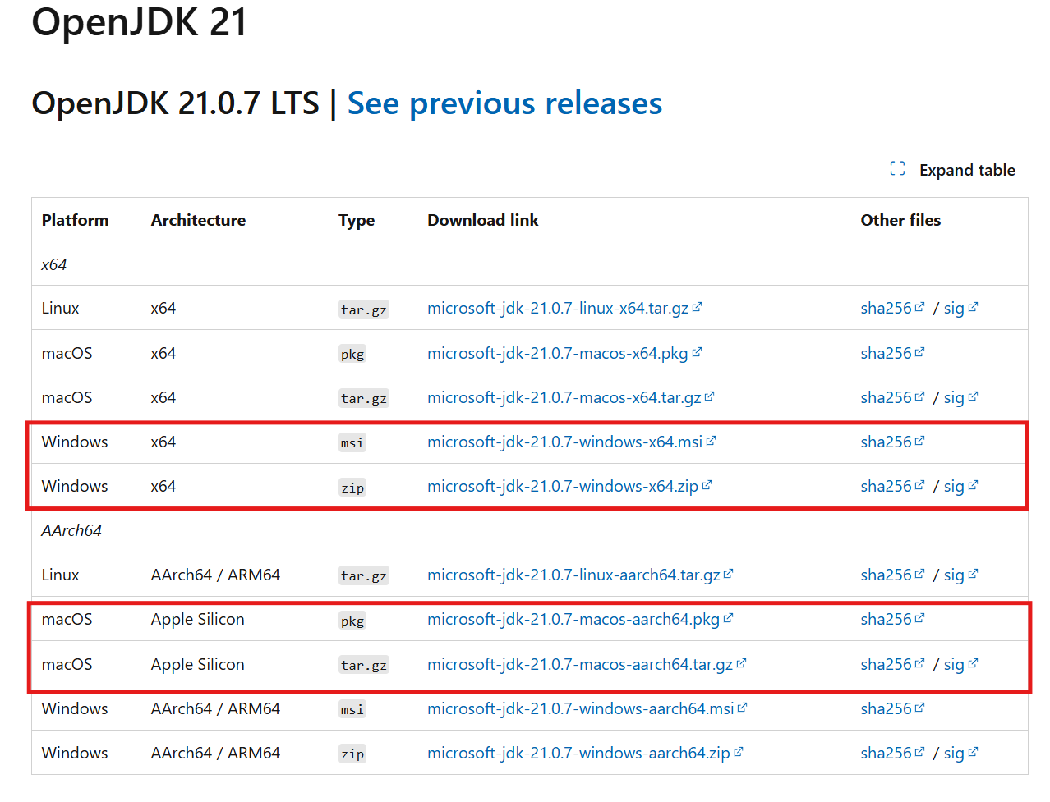

Slide 4
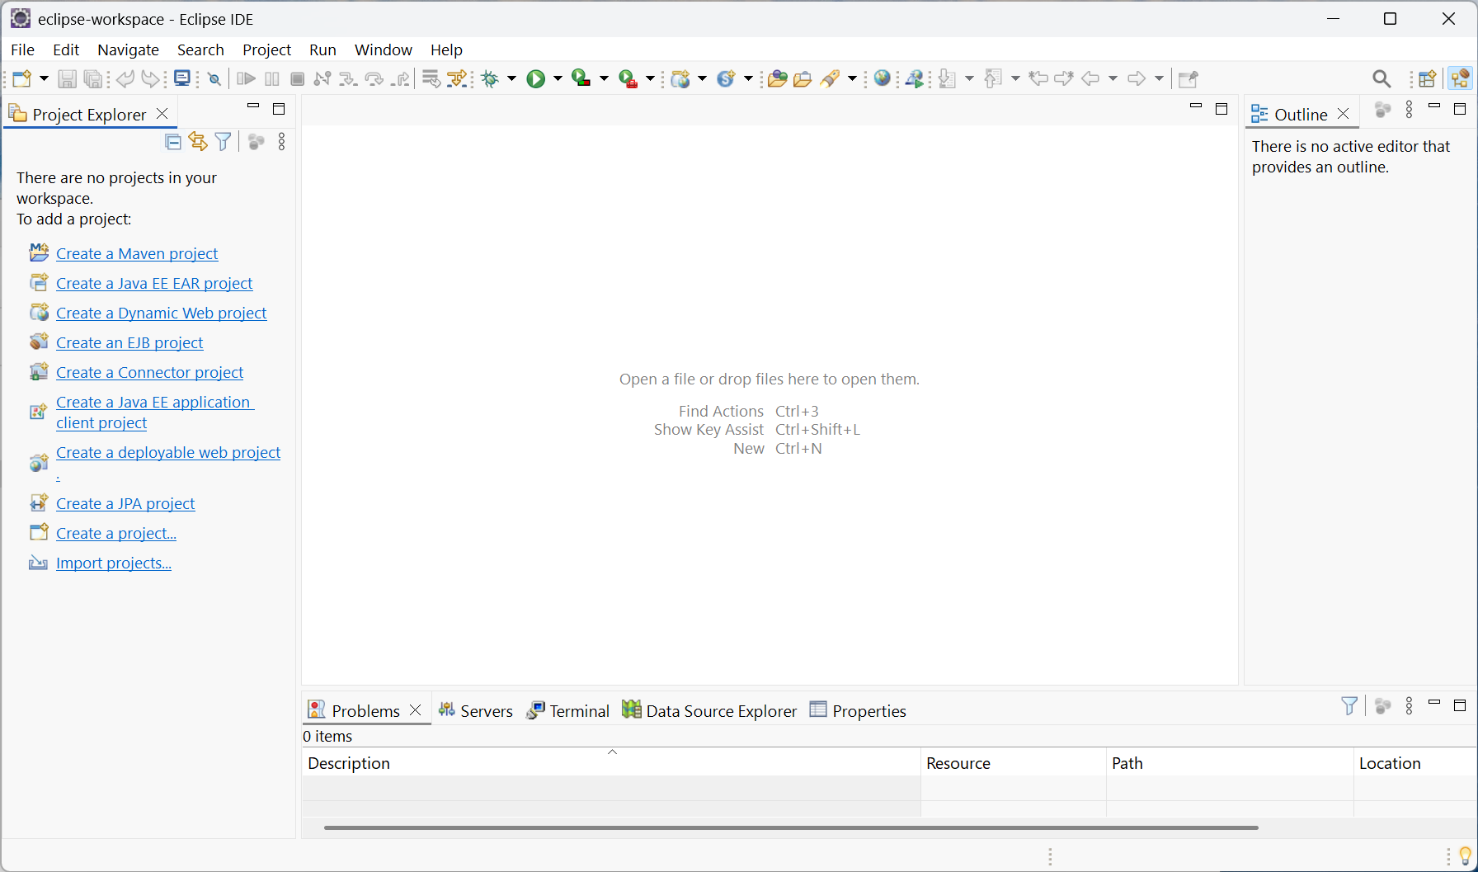
IDE - Eclipse
https://www.eclipse.org/downloads/

Slide 5
Java Basics
https://www.w3schools.com/java/default.asp

